Slide 1
NATURAL LANGUAGE PROCESSING
Muhammad Umair Khan
Muhammad Mujtaba
Umer Anwer
Sineh Dhingana

Slide 2
WHAT IS NLP?
Natural language processing (NLP) is a subfield of linguistics, computer science, information engineering, and artificial intelligence concerned with the interactions between computers and human (natural) languages, in particular how to program computers to process and analyze large amounts of natural language data.

Slide 3
HISTORY:
The history of natural language processing (NLP) generally started in the 1950s, although work can be found from earlier periods. In 1950, Alan Turing published an article titled "Computing Machinery and Intelligence" which proposed what is now called the Turing test as a criterion of intelligence
Challenges in natural language processing frequently involve speech recognition, natural language understanding, and natural language generation.

Slide 4
Word Embedding

Slide 5
WHAT DOES IT MEAN?
It is a representation of document vocabulary.
They are vector representation of a particular word.
word2Vec is the one of popular technique to learn it.

Slide 6
why do we need them?
For example consider 2 sentences (have a great day and have a good day).
V={have,a,great,good,day},V={5}.
Have = [1,0,0,0,0]; a=[0,1,0,0,0] ; good=[0,0,1,0,0] ; great=[0,0,0,1,0] ; day=[0,0,0,0,1]
To display these encoding we will need 5 dimensional space.

Slide 7
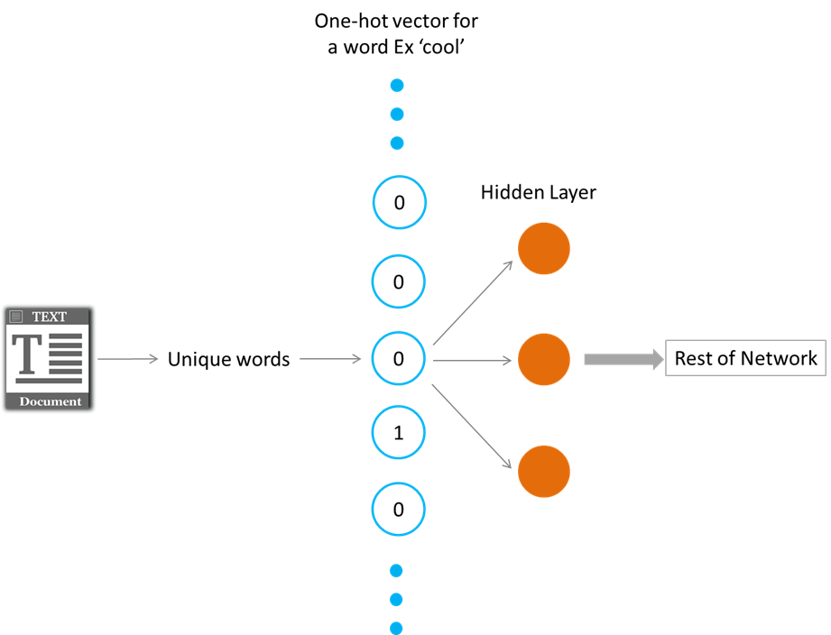
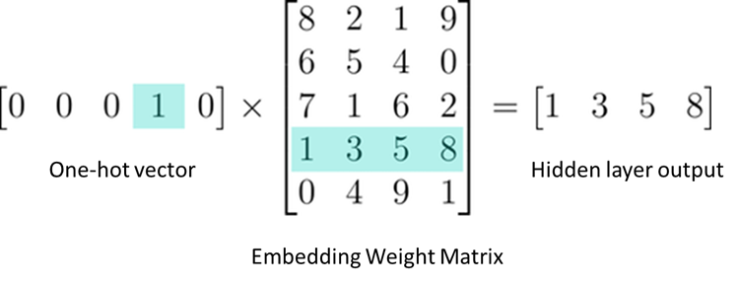
How Does WORD2DEC Work?
There are two methods (both involving neural networking).
1)skip gram.
2)common bag of words.
These methods takes context of each word as input.
It tries predict the corresponding word.
It greatly improves efficiency of our network.
Embedding are just like a fully connected layer.

Slide 8
Latent Semantic Analysis

Slide 9
What is Latent Semantic Analysis?
Latent semantic indexing (LSI) is an indexing and retrieval method that uses a mathematical technique called singular value decomposition (SVD) to identify patterns in the relationships between the terms and concepts contained in an unstructured collection of text. LSI is based on the principle that words that are used in the same contexts tend to have similar meanings.

Slide 10
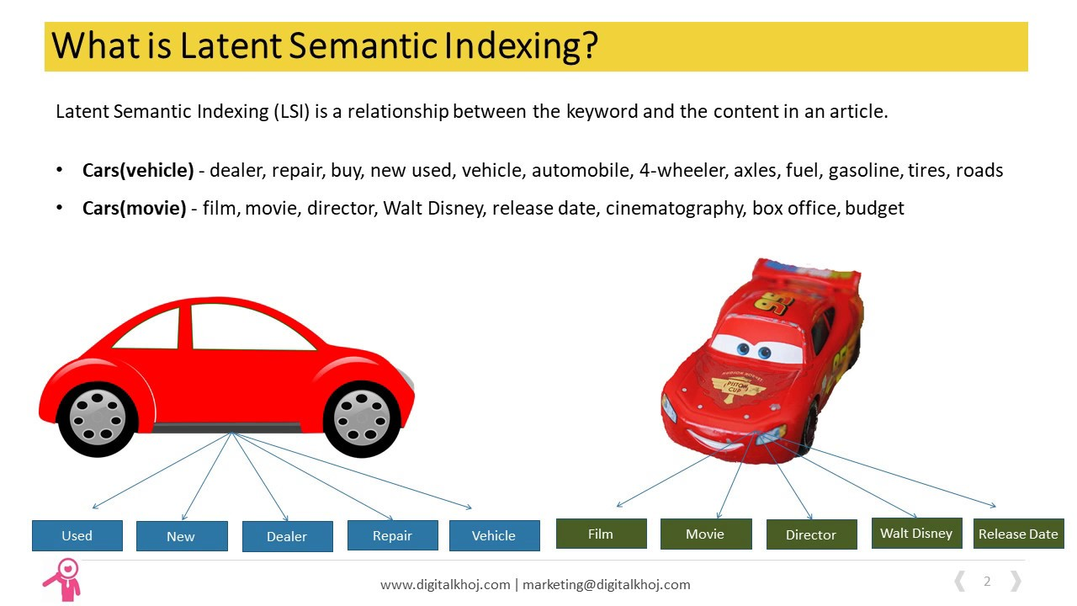

Slide 11
Applications:
Widely used in search engines.
Used in detecting plagiarism.
Compares text similarities.

Slide 12
CONCLUSION:
Linear Algebra is considered as one of the foundational blocks of Data Science. You cannot build a skyscraper without a strong foundation.
With an understanding of Linear Algebra, you will be able to develop a better intuition for machine learning and deep learning algorithms and not treat them as black boxes. This would allow you to choose proper hyper parameters and develop a better model.
You would also be able to code algorithms from scratch and make your own variations to them as well. Isn’t this why we love data science in the first place? The ability to experiment and play around with our models? Consider linear algebra as the key to unlock a whole new world.

Slide 13
THANK YOU !!

